Slide 1
ARACHNE Network Studies

Slide 2
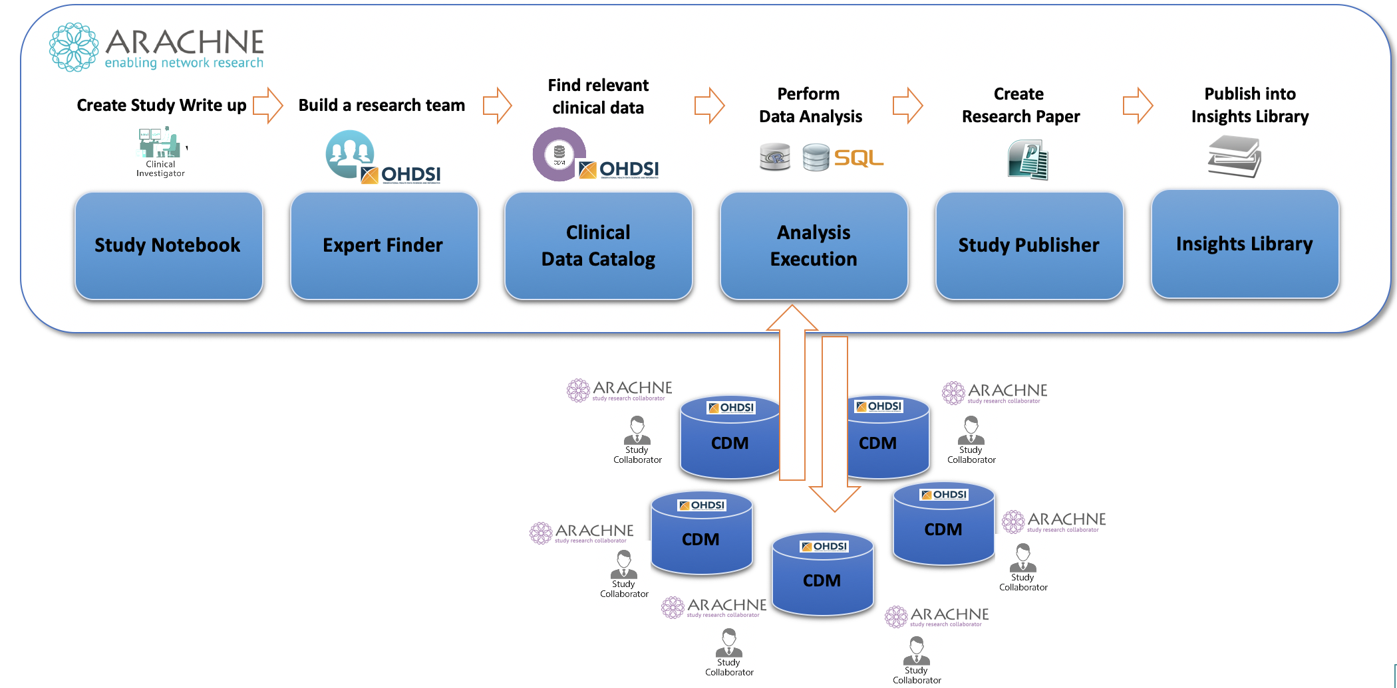
ARACHNE Network Research
The ARACHNE Research Network platform enables collaborative federated studies across healthcare organizations, data owners and researches.

Slide 3
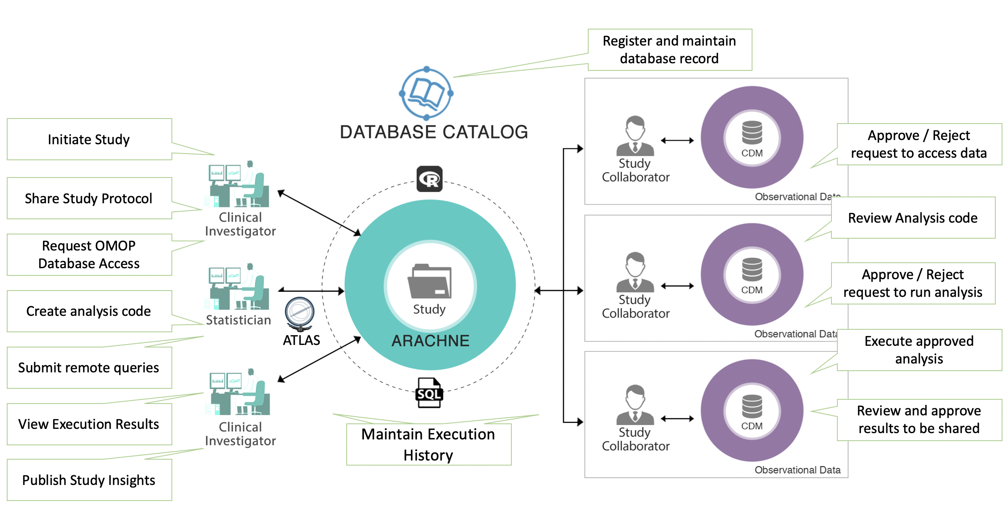
ARACHNE Study Process

Slide 4
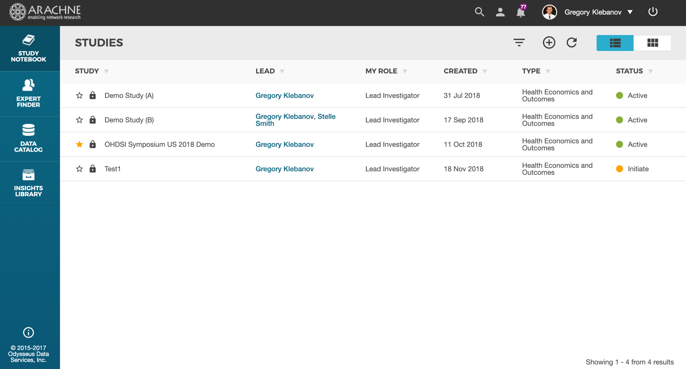
ARACHNE Study List
Display a list of studies

Slide 5
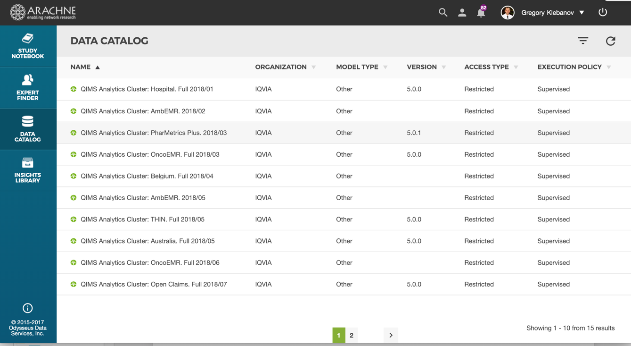
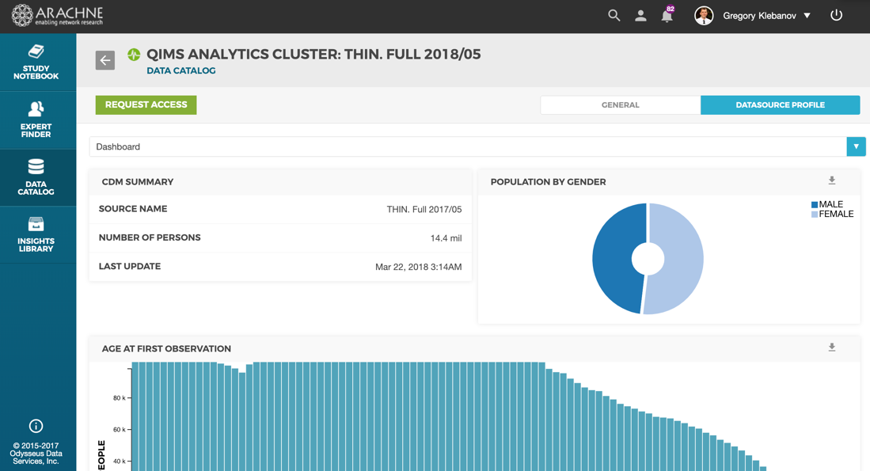
ARACHNE Data Catalog
Display a list of available network data sets
Display an individual data set details, including available ACHILLES reports

Slide 6
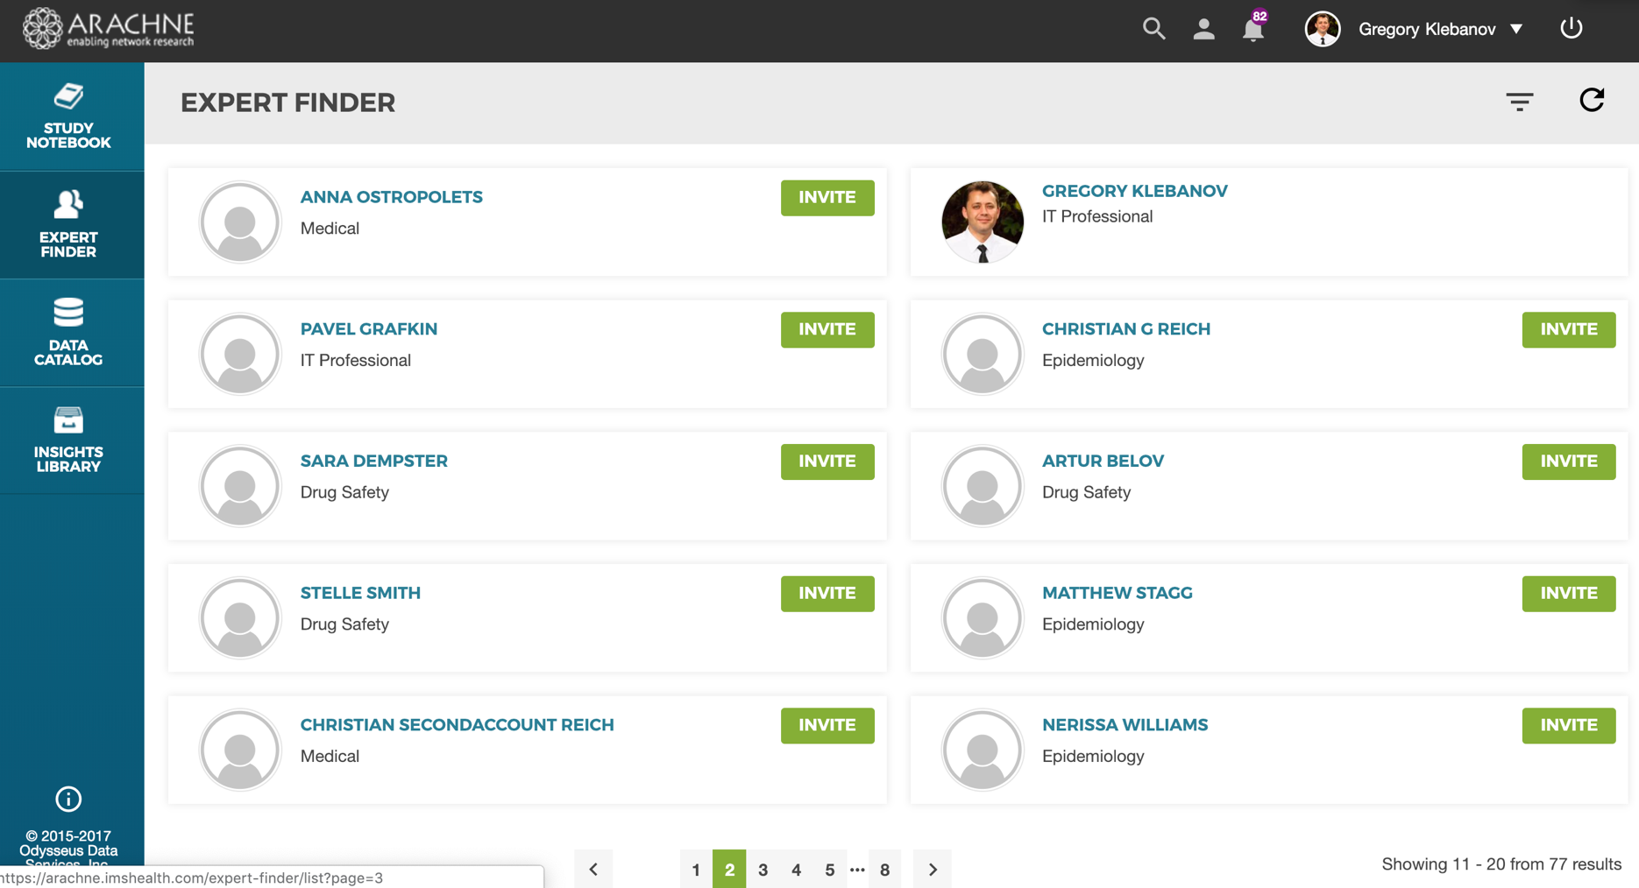
ARACHNE Network Users
Display a list of network collaborators

Slide 7

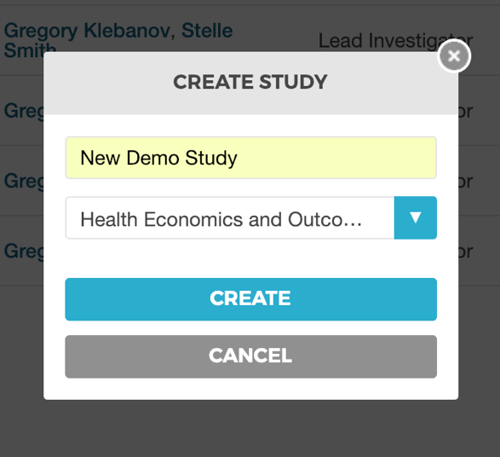
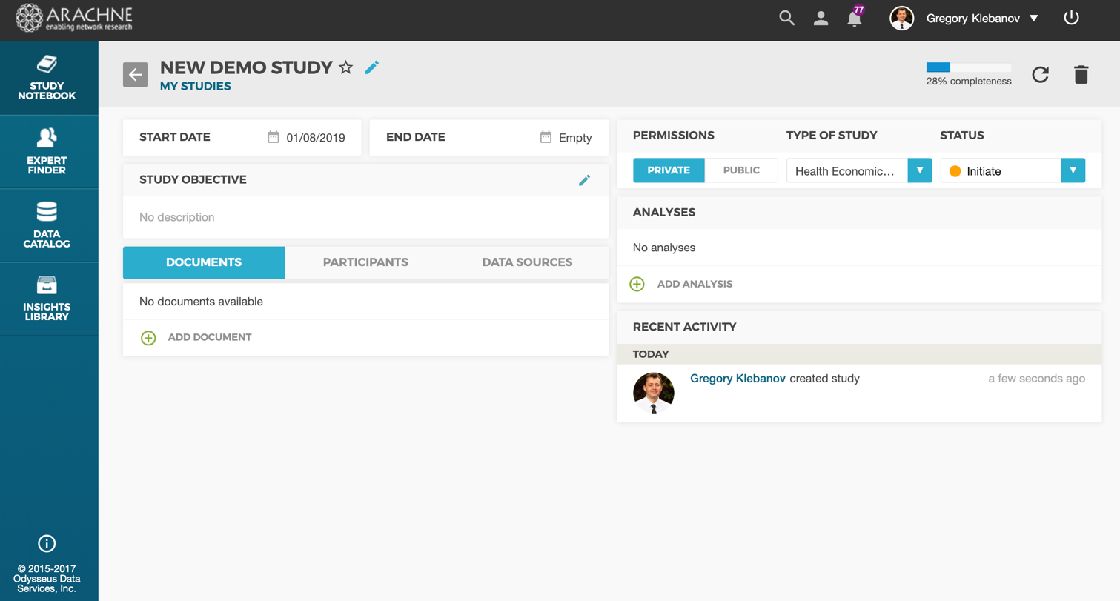
New ARACHNE study
Create New Study

Slide 8
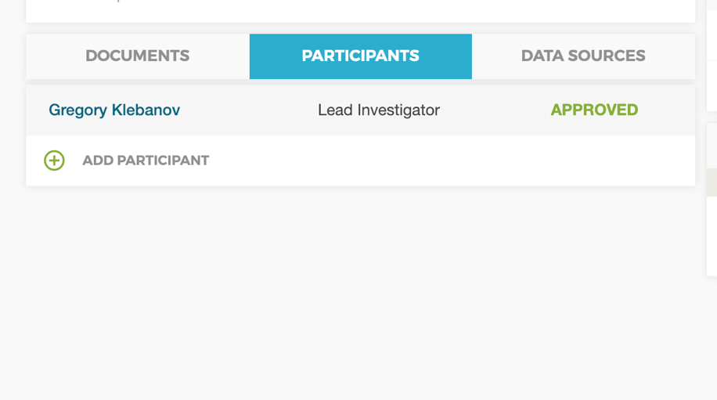
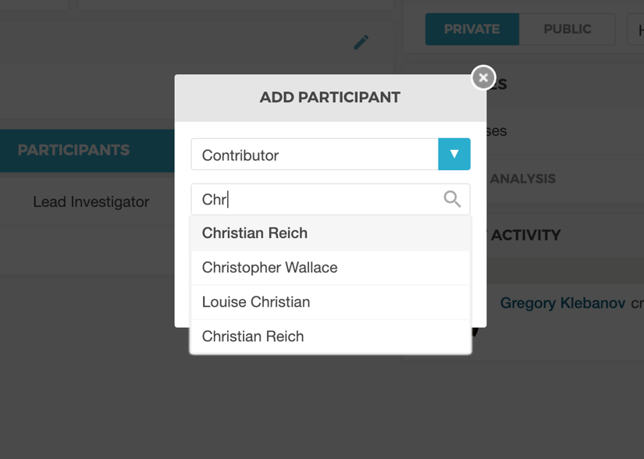
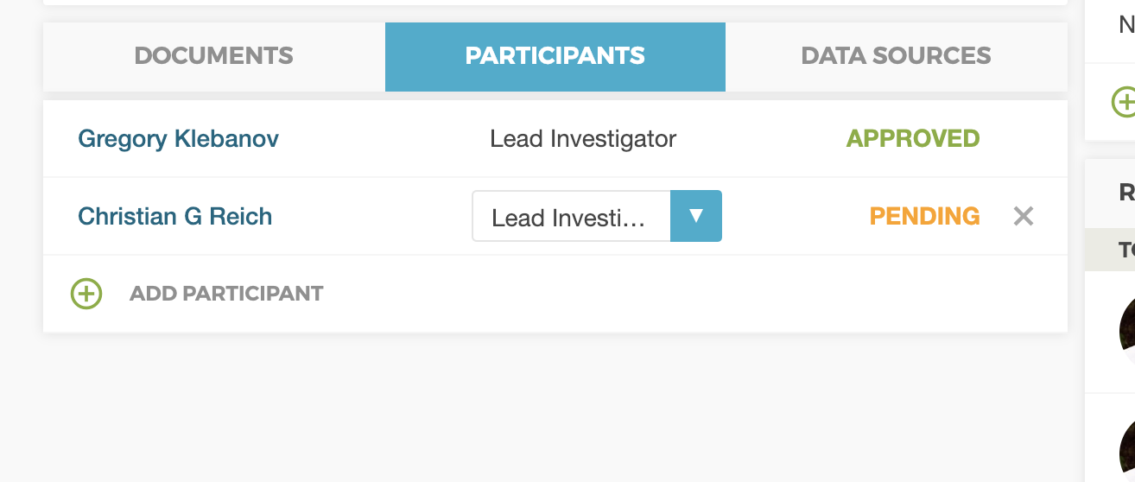
Study Participants
Lookup participant by name and specify study role
Invite study participant

Slide 9
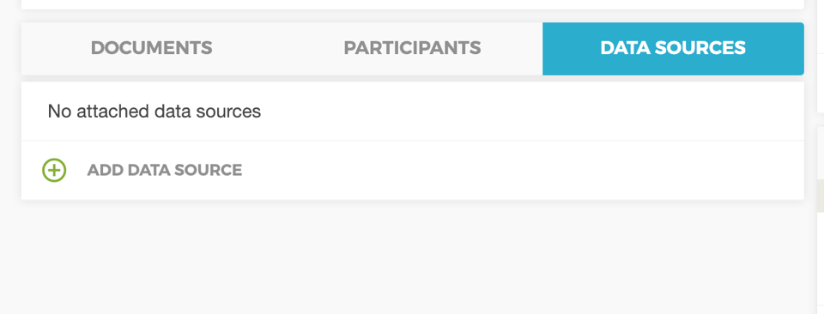
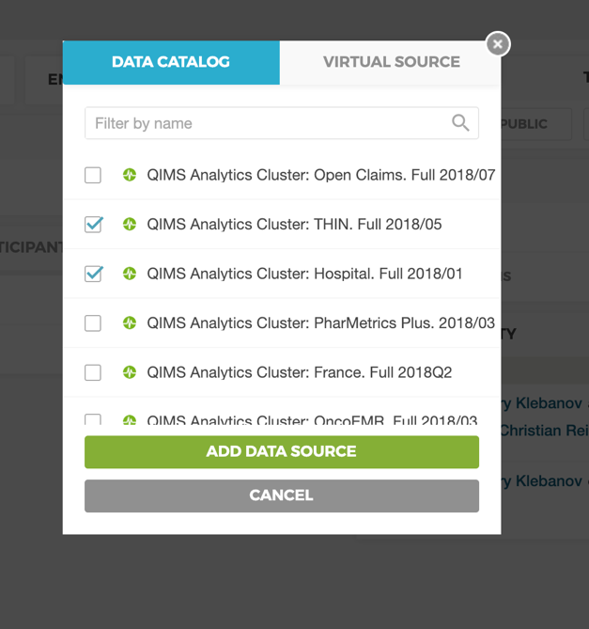
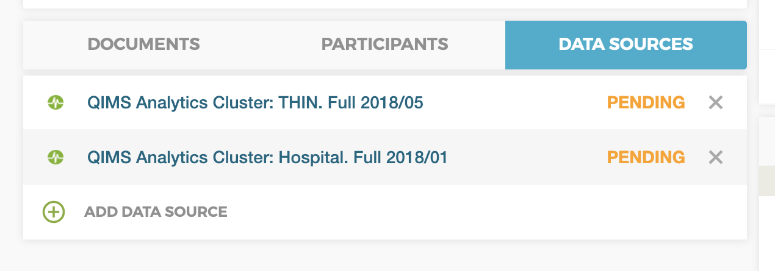
Requesting access to data
Select data sets and click “Add Data Source” button
Request access to data
The request will be sent to the data set owner for approval

Slide 10
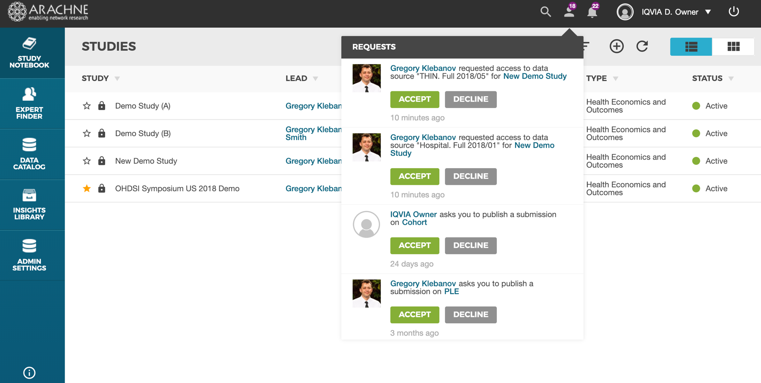
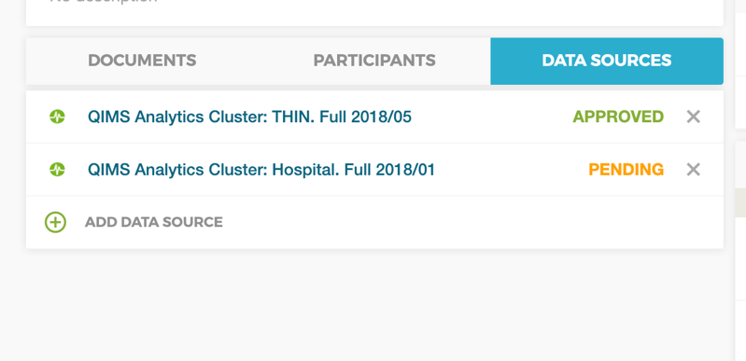
Data Owner: Approving Data Access
Data Set Owner will receive a request and can approve or decline it

Slide 11
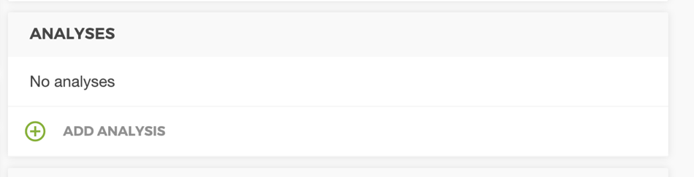
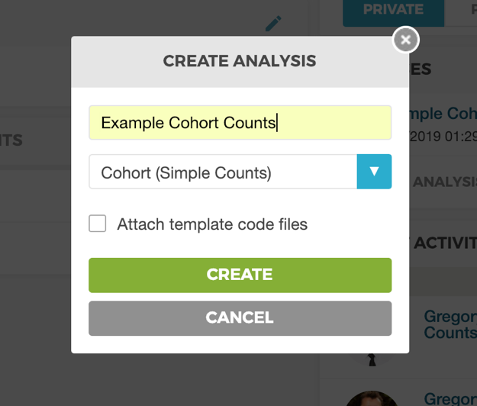
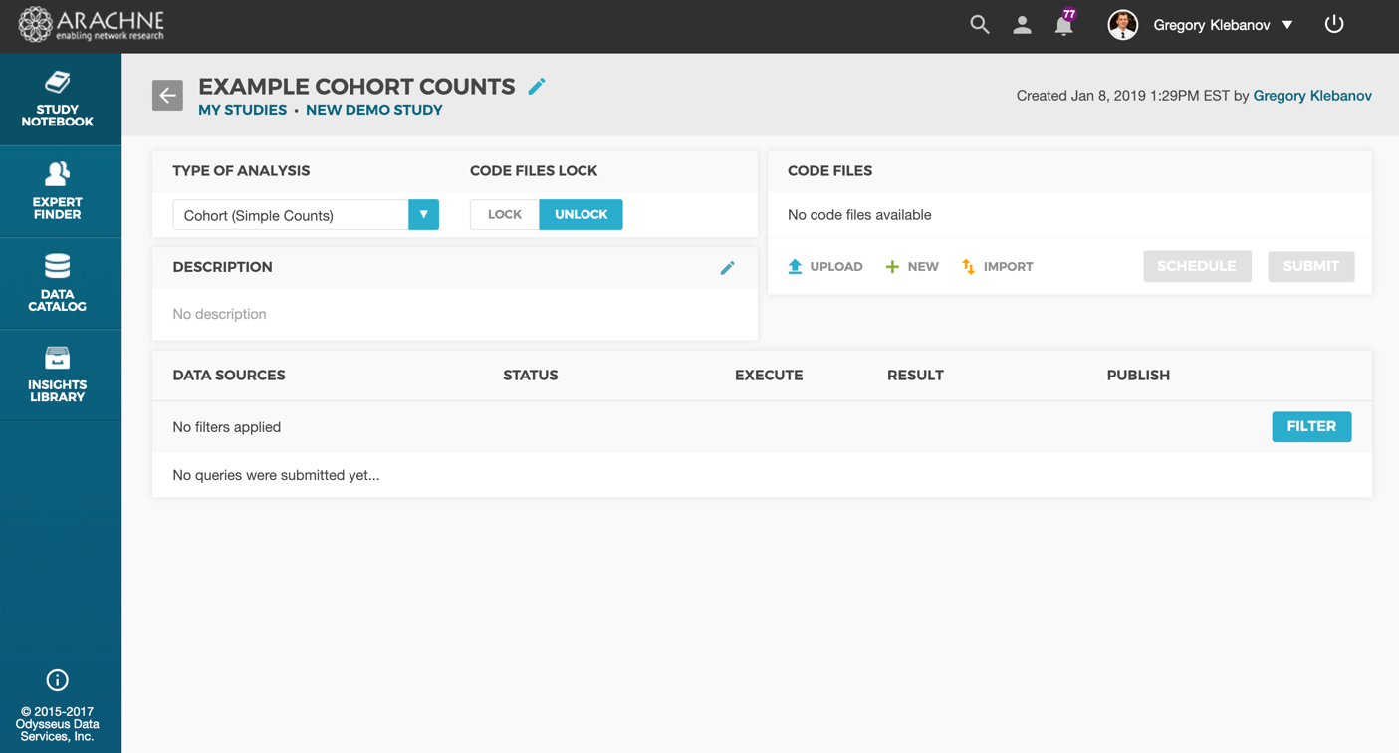
Analysis: Cohort Feasibility Counts
Type analysis name and select analysis type to be Cohort (Simple Counts)
Add new analysis

Slide 12
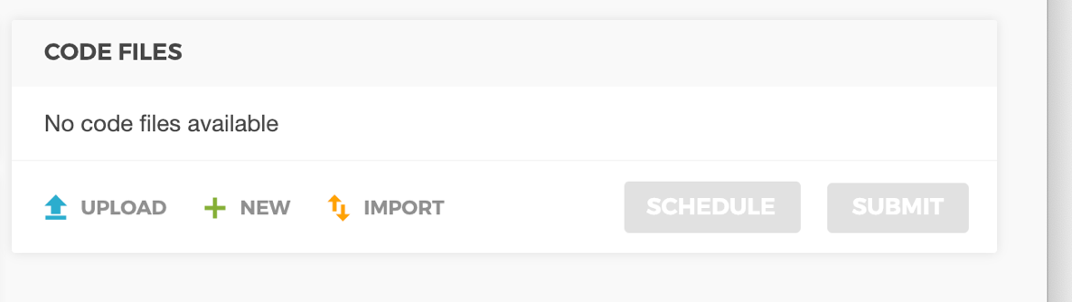
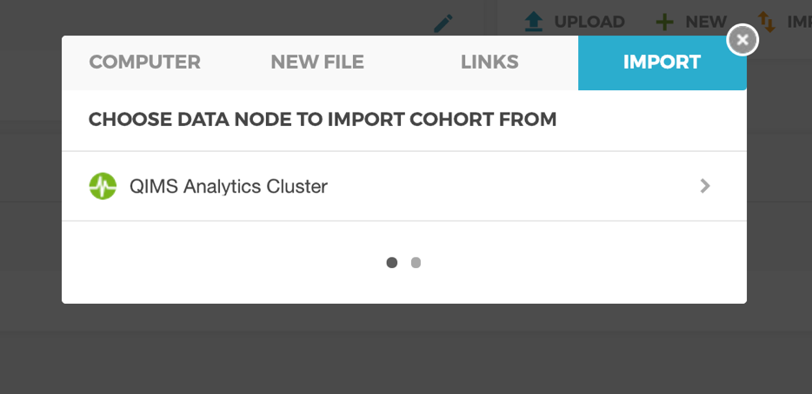
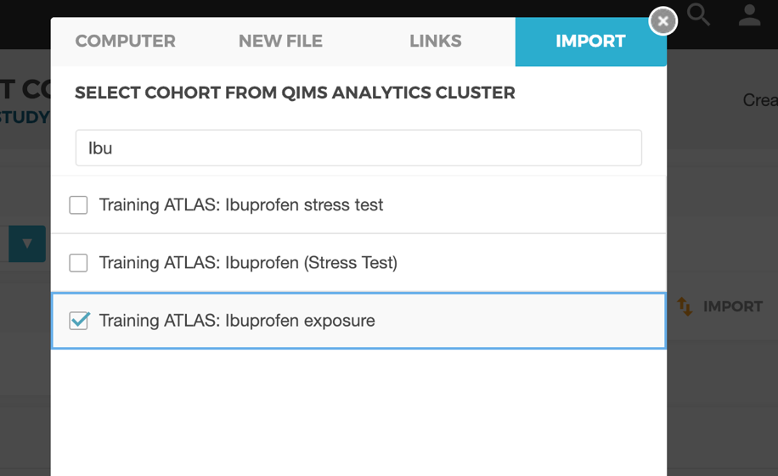
Analysis: Import design from ATLAS
Select data node with ATLAS connected
Import Cohort definitions from ATLAS connected to the data node
Chose cohort to be imported and click the “Import” button

Slide 13
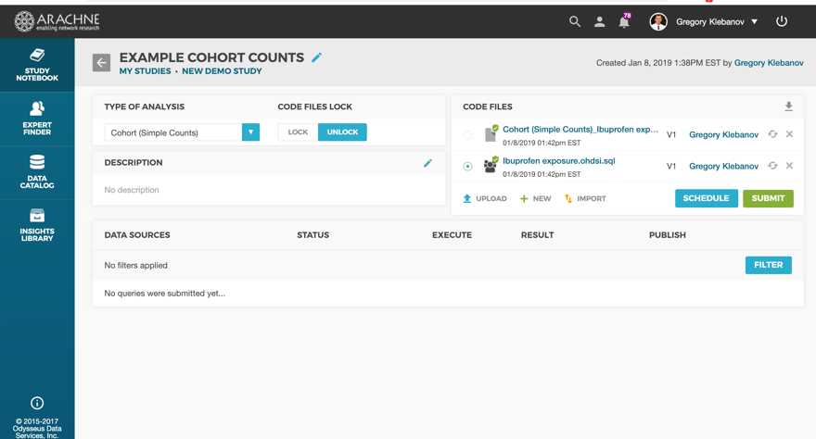
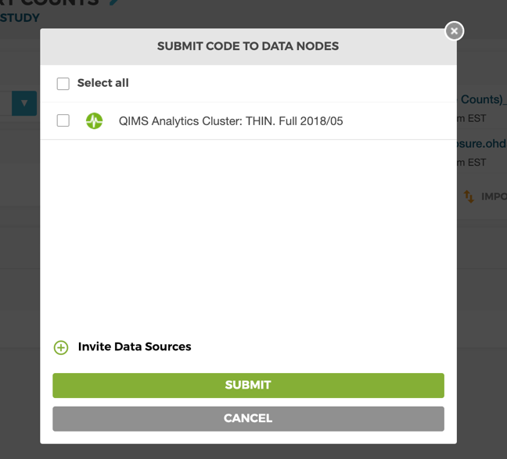
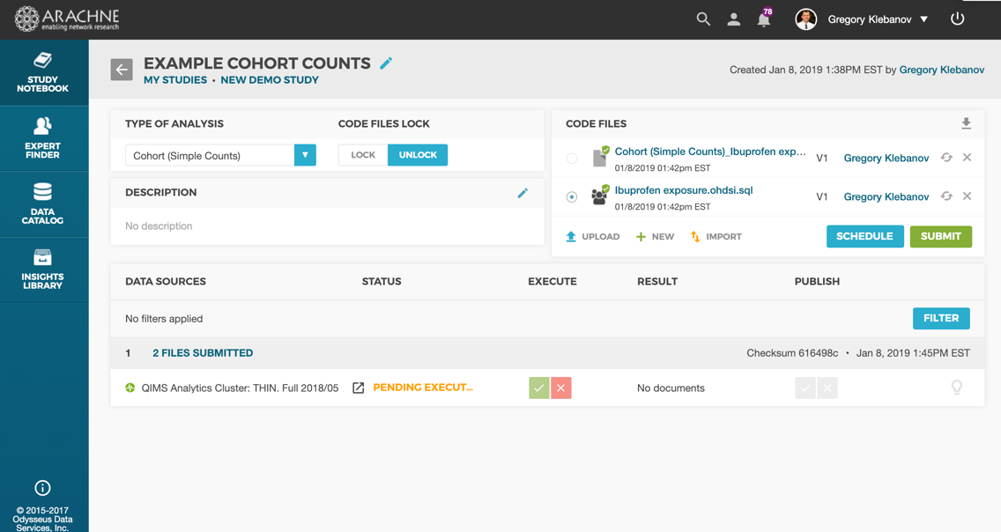
Analysis: Execute Cohort Counts
Click “Execute” button, select data sets to execute against and click “Submit”
The submission will appear in the the queue. Depending on data set’s policy, the request might require an approval from the data set owner

Slide 14
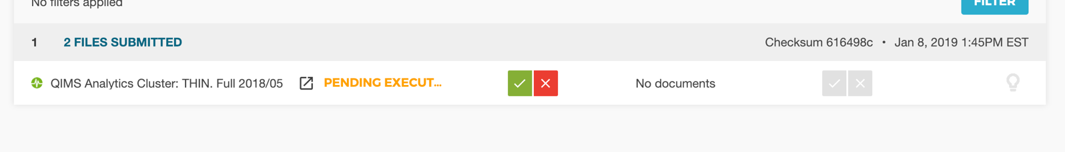

Analysis: Approving Submissions
The data set owner receives a request to execute an analytical query and can approve or reject the execution request or results of the execution
Once query results are approved to be published, they will become visible to the rest of the study team

Slide 15
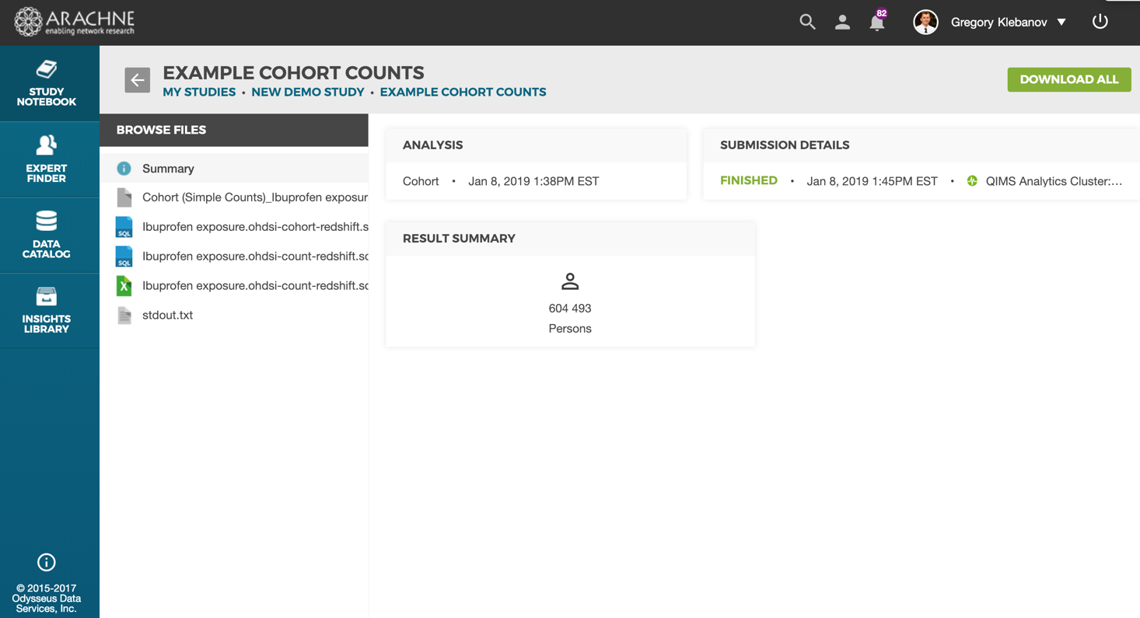
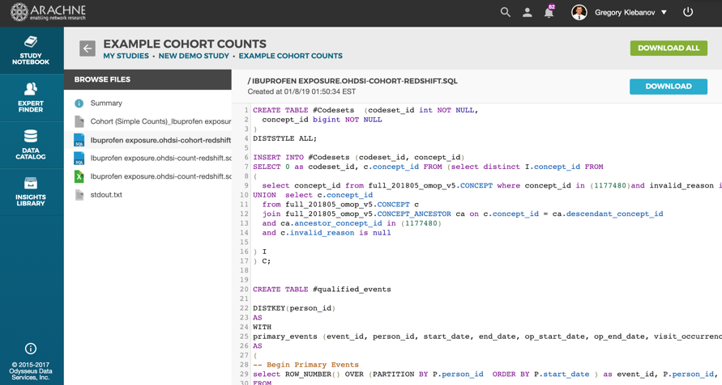
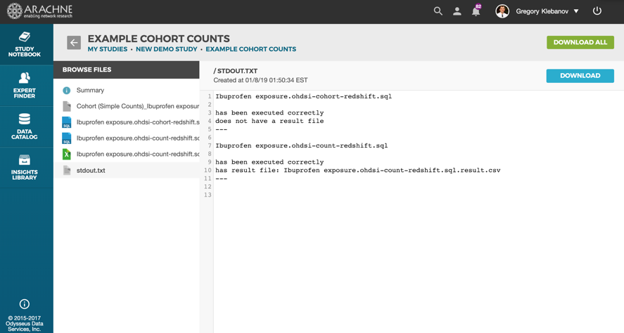
Analysis: Viewing Submission Results
The cohort count results contain a simple count of patients, as well as cohort code used and debugging information

Slide 16
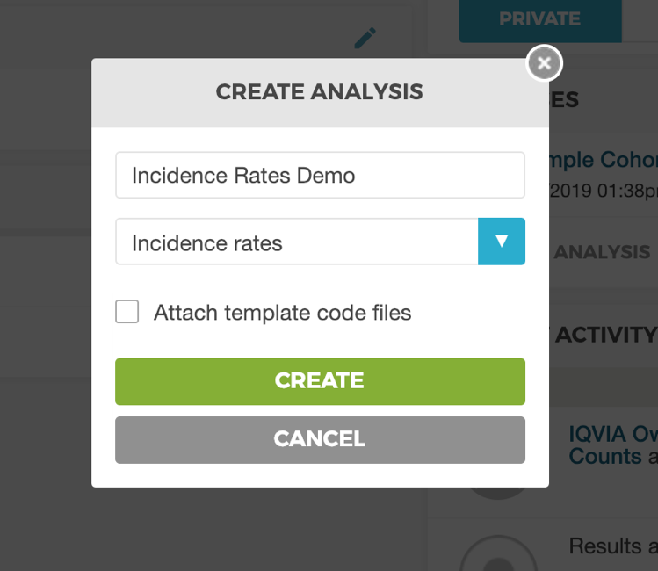
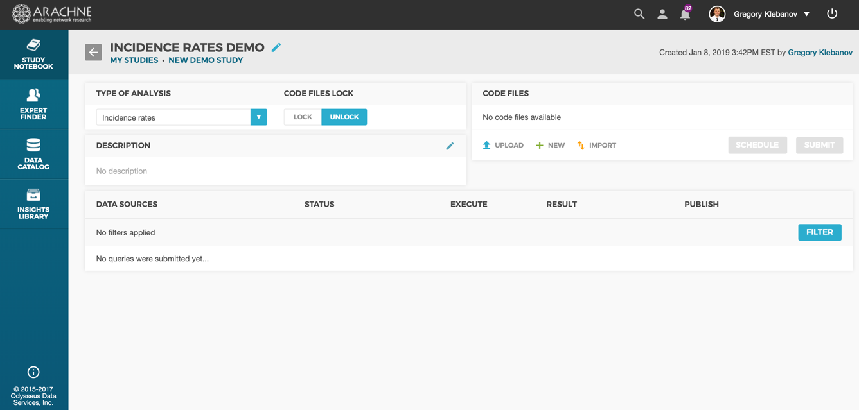
Analysis: Incidence Rates
Type analysis name and select analysis type to be Cohort (Incidence Rates)
Add new analysis

Slide 17
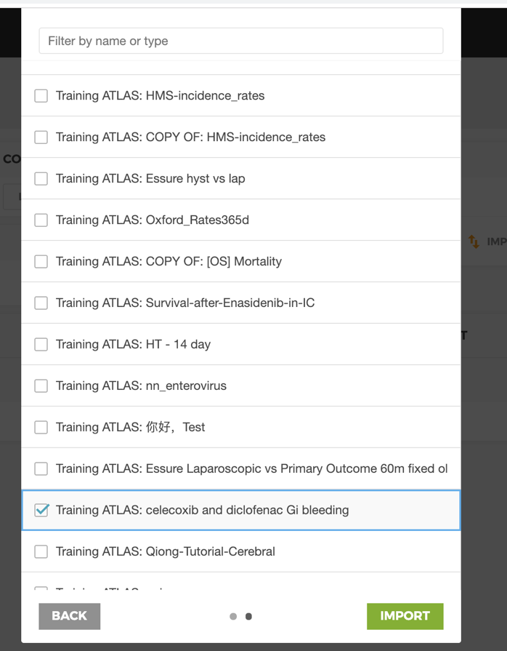
Analysis: Import IR design from ATLAS
Select data node with ATLAS connected
Import IR definitions from ATLAS connected to the data node
Chose IR analysis to be imported and click the “Import” button

Slide 18
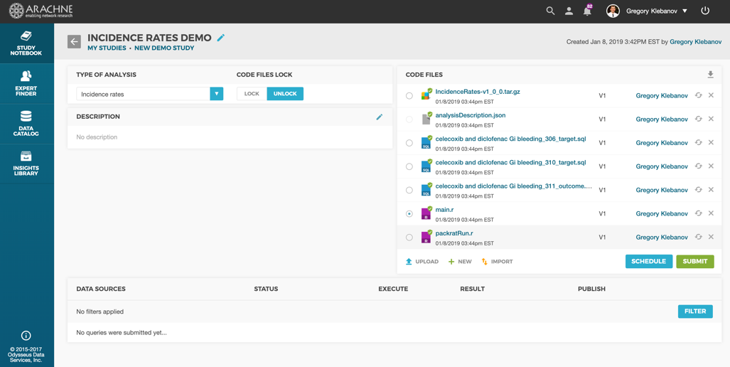
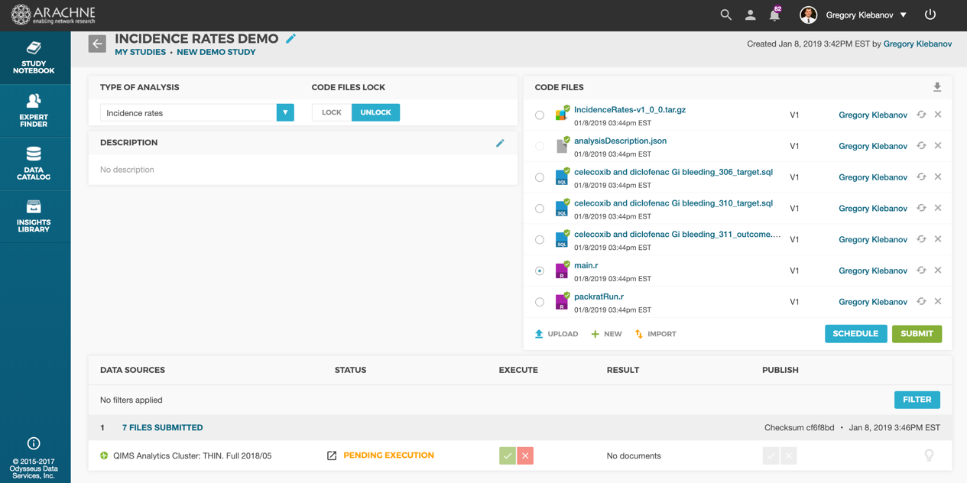
Analysis: Execute Cohort Counts
Click “Execute” button, select data sets to execute against and click “Submit”
The submission will appear in the the queue. Depending on data set’s policy, the request might require an approval from the data set owner

Slide 19
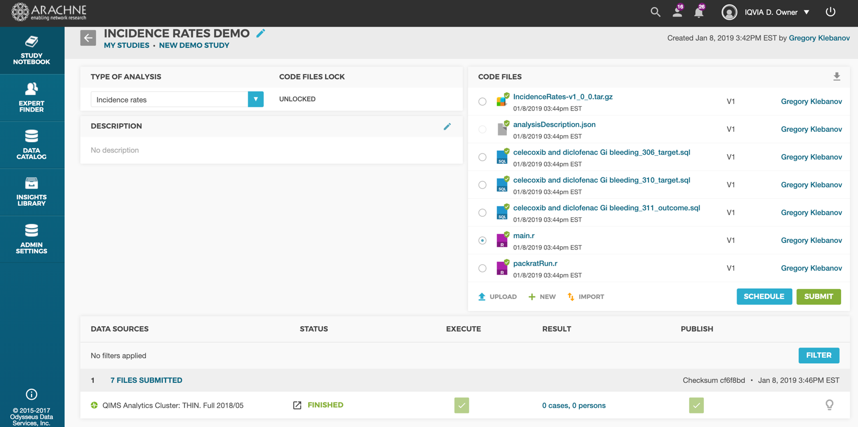
Analysis: Approving Submissions
The data set owner receives a request to execute an analytical query and can approve or reject the execution request or results of the execution
Once query results are approved to be published, they will become visible to the rest of the study team

Slide 20
Network Study Coding Best Practice

Slide 21
R and SQL coding Best Practices
Do not hardcode local path, use relative path from working directory with getwd()
Do not install external packages - ARACHNE comes with all default OHDSI packages. In case of missing non-OHDSI packages, attach the package as .tar.gz to analysis and install it from the file instead of downloading it from the network since external traffic could be blocked the site’s firewall
Avoid creating permanent tables for calculations - use Temp tables instead to avoid issues with concurrency
Code SQL in OHDSI.SQL standard and translate + render it using OHDSI/SqlRender
Execute SQL by using OHDSI/DatabaseConnector
When possible, do calculations in SQL vs. R - in most cases that's more performant

Slide 22
Retrieving Local Database Connection
Retrieve connection details for the requested Data Source by reading system variables:
dbms <- Sys.getenv("DBMS_TYPE")
connectionString <- Sys.getenv("CONNECTION_STRING")
user <- Sys.getenv("DBMS_USERNAME")
pw <- Sys.getenv("DBMS_PASSWORD")
cdmSchema <- Sys.getenv("DBMS_SCHEMA")
resultsSchema <- Sys.getenv("RESULT_SCHEMA")

Slide 23
OHDSI.SQL template conventions
@cdm_database_schema – OMOP CDM schema
@vocabulary_database_schema – OMOP Vocabulary schema
@target_database_schema – ATLAS Results schema
@target_database_schema.@target_cohort_table – cohort table

Slide 24
ARACHNE Manual Mode Deployment Options

Slide 25
ARACHNE Deployment options
ARACHNE Network Central
Option 1 - ARACHNE Data Node on Site.
Use ARACHNE Central to exchange and execute code through through Data Node Execution Engine without a need for a separate R Server or SQL access.
Pros: increased productivity and consistency, scalability
Option 2 – No data node on site. Use ARACHNE Central to exchange code and execute through a separate local R Server or SQL Interface. Cons: larger effort for data owners and the lack of execution results consistency
Federated Study
Organization 1
Organization 2
ARACHNE Data Node
SQL Workspace
R Server
CDM
CDM

Slide 26
Join the Journey
http://ohdsi.org

